Slide 1
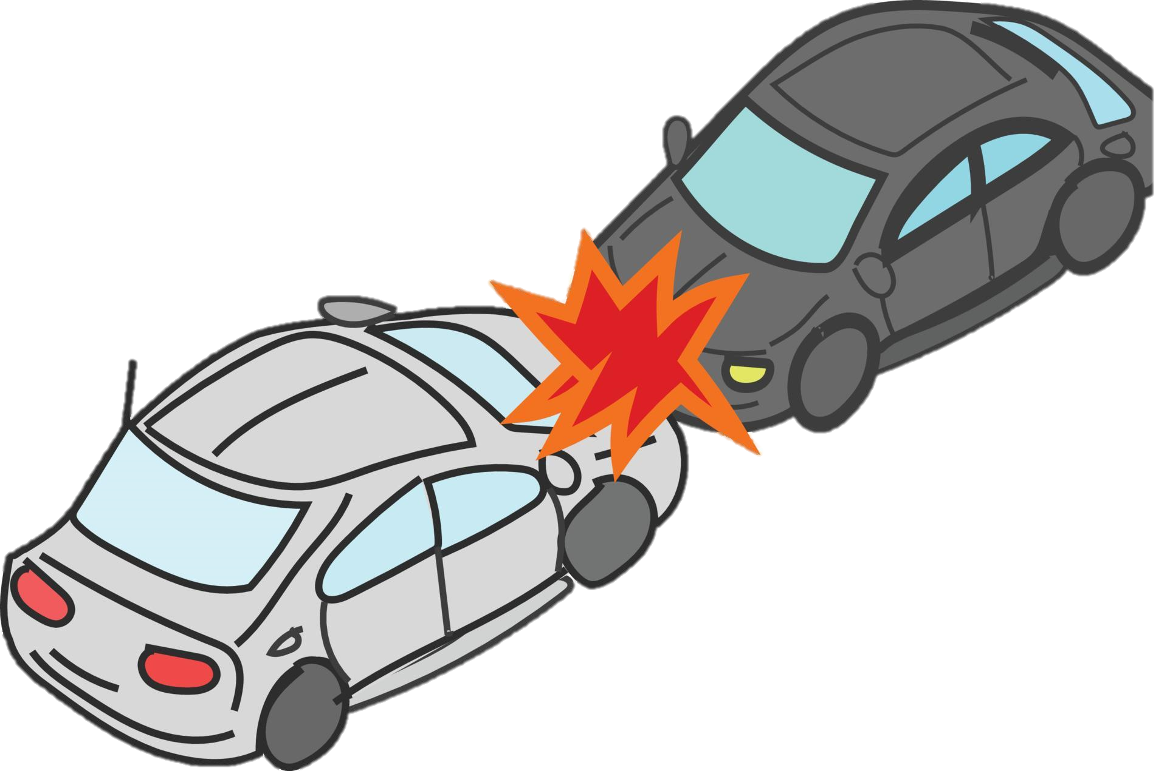
Beyond the Crash: Deconstructing the Web of Accident Causation
By: Group 7

Slide 2

Members of Group 6
Faith Koech
Lucy Muchiri
Timothy Munene
Munene Gitonga
Isaac Macharia
Thomas Amuti

Slide 3
Highlights
Project Overview
Business Understanding: Business Problem and Objectives
Data Understanding
Data Preparation
Results
Recommendations
Limitations and Suggestions for further studies

Slide 4
Project Overview
Traffic accidents are a common and persistent public safety issue.
Associated with injury and/or death as well as financial loss in repair costs.
Accidents are primarily attributable to either:
Human related factors such as distracted driving.
Vehicle related factors such as pre-existing vehicle defect.
Environmental related factors such as poor weather.
Understanding the role that these factors play is essential to reducing traffic accidents and developing effective safety measures.

Slide 5
Business Questions
This project therefore seeks to answer the following business questions:
What are the most common primary contributory causes of traffic accidents?
How do human characteristics contribute to accident occurrence?
How do vehicle characteristics contribute to accident occurrence?
How do environmental conditions such as weather influence accident occurrence?
Are there specific times when accidents are more likely to occur?
How does road design impact the likelihood of accidents?
Can we accurately predict the primary cause of an accident given the human, vehicle, environmental, temporal and road design characteristics?

Slide 6
Stakeholders who may benefit
Government and city authorities who can identify high risk areas and improve on road infrastructure while implementing policies aimed at reducing accidents.
Public safety organizations such as the Vehicle Safety Board who might use the data to aid in designing regulation and safety campaigns.
General public and drivers who might benefit from better awareness of risk factors.
Vehicle manufacturers who might leverage on insights to improve car safety features such as weather detection systems.

Slide 7
Data Understanding
This project utilized 3 datasets that contain information on the:
Accident occurrence
Characteristics of people involved
Vehicle characteristics
The datasets used were:
City of Chicago Accident Dataset that has 1.04 million rows and 48 columns.
Vehicle Accident Dataset that has 2.28 million rows and 29 columns.
Driver/Passenger Accident Dataset that has 2.12 million rows with 71 columns.

Slide 8
Data Preparation – Libraries used
We used several libraries to prepare and analyse the dataset:
Pandas - to read our csv files and perform exploratory data analysis.
Matplotlib - for visualizations.
Scikit-learn – for model fitting and evaluation. The models used were:
Decision Forest Classifier – Base model to capture complex patterns in the dataset.
Random Forest Classifier - To handle high dimensional data.
Neural Networks – To handle situations of class imbalance.

Slide 9
Data Cleaning – Selecting columns
Prior to data analysis we selected the following columns from the following datasets:
City of Chicago Dataset:
Lighting condition - Light condition at time of crash.
Weather condition - Weather condition at time of crash.
Road defects - Road defects, as determined by reporting officer.
Crash type - A general severity classification for the crash. Can be either Injury and/or Tow Due to Crash or No Injury / Drive Away.
Primary Contributory Cause - The factor which was most significant in causing the crash.
Crash hour - The hour of the day component of CRASH_DATE.
Crash day - The day of the week component of CRASH_DATE.
Crash month - The month component of CRASH_DATE.

Slide 10
Data Cleaning – Selecting columns
Vehicle Dataset:
Number of passengers - Number of passengers in the vehicle. The driver is not included.
Make - The make (brand) of the vehicle.
Vehicle Use - The normal use of the vehicle.
Vehicle Defect - Defect the vehicle had.
Exceeds speed limit - Whether vehicle exceeded speed limit.
Passenger Dataset:
Person type - Type of roadway user involved in crash.
Sex - Gender of person involved in crash.
Age - Age of person involved in crash.
Driver Vision - What, if any, objects obscured the driver’s vision at time of crash.
Physical Condition - Driver’s apparent physical condition at time of crash.
Driver Action - Driver action that contributed to the crash.
Pedpedal Action - Action of pedestrian or cyclist at the time of crash.

Slide 11
Final Output from Data Cleaning
All 3 data sets were merged with a total of 21 columns and 1,192,524 entries.
Dataset were filtered to contain ONLY the data that focused on drivers.
‘Exceeding speed limit’ and ‘pedestrian action’ columns were dropped since they contained > 95% missing data.
The column ‘Age’ was also noted to have a large number of missing values which was 26.6% of total data.
The column also had negative values.
Filling the missing values would have led to erroneous results.
Therefore both the missing and negative values were dropped.
Final total entries were: 858,550 rows and 21 columns.

Slide 12
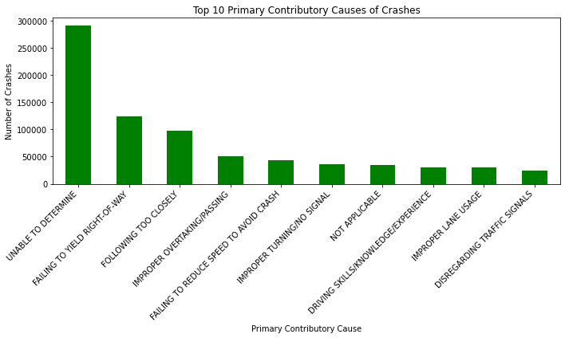
Results – Primary Contributory Causes

Slide 13
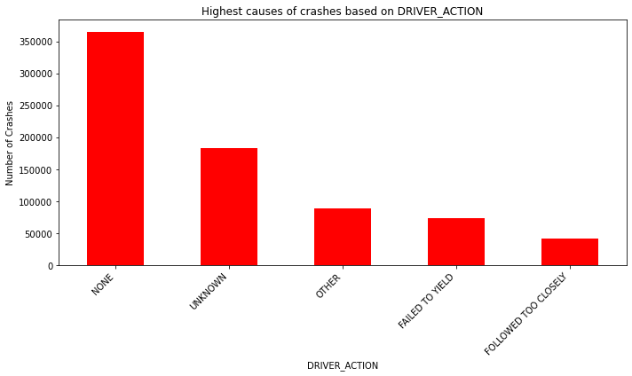
Accident Crashes based on driver’s action

Slide 14
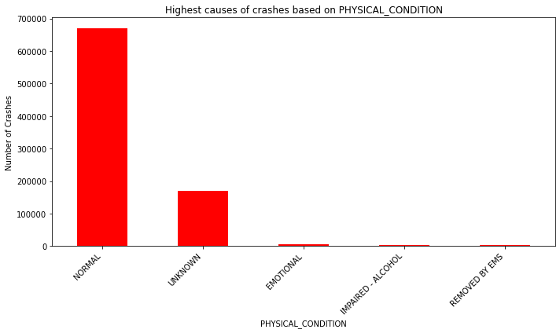
Accident Crashes based on driver’s physical condition

Slide 15
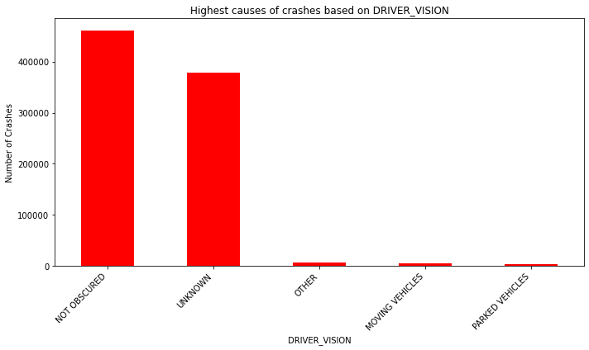
Accident Crashes based on driver vision

Slide 16
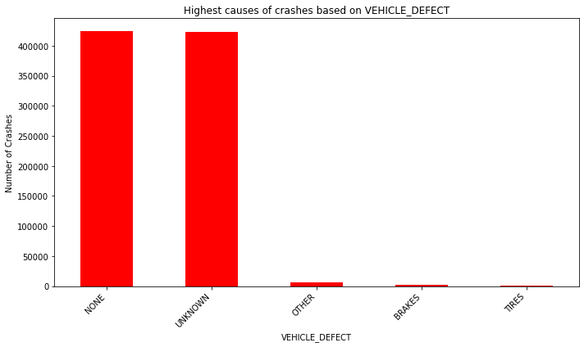
Accident Crashes based on vehicle defect

Slide 17
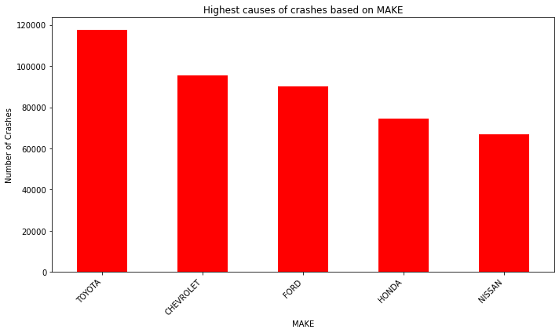
Accident Crashes based on vehicle make

Slide 18
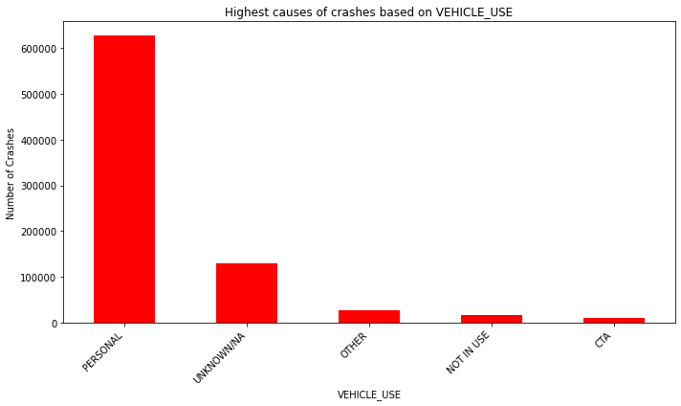
Accident Crashes based on vehicle use

Slide 19
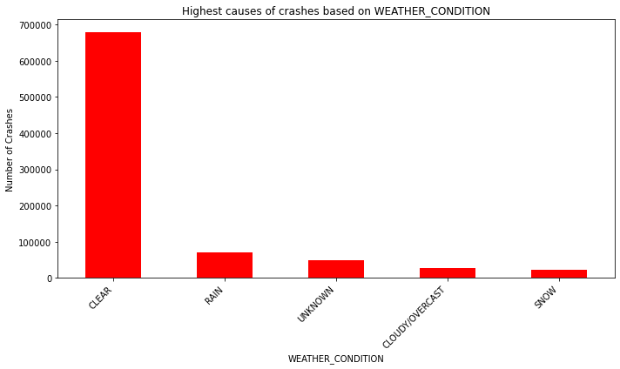
Accident Crashes based on weather condition

Slide 20
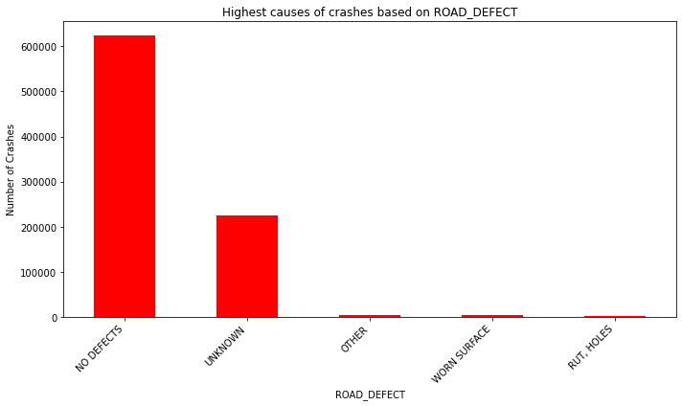
Accident Crashes based on road defect

Slide 21
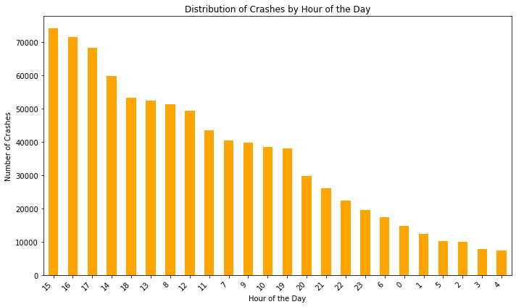
Accident Crashes based on hour of the day

Slide 22
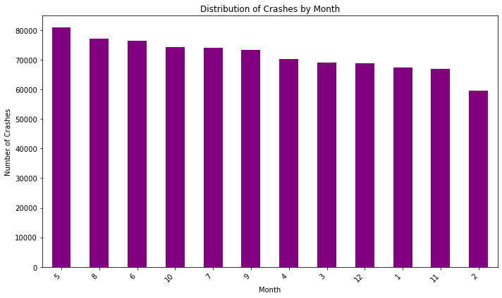
Accident Crashes based on month of the year

Slide 23
Model results
We started by building baseline models including Decision Tree, Random Forest Classifier, and Neural Network
Initial models suffered from class imbalance by overfitting.
We improved the model by grouping the target variable into 5 broad causes (Environmental, Vehicle Defect, Impairment/Distraction, Driver Error, and Unknown)
The Neural Network emerged as the best-performing model, balancing training and testing accuracy and successfully capturing complex patterns.

Slide 24
Model results
The following were the final training and test accuracies for the models:
 | Decision Tree | Random Forest | Neural Network
Training Accuracy | 55.03% | 71.26% | 95.94%
Test Accuracy | 54.42% | 69.66% | 93.56%

Slide 25
Key features in predicting contributory cause of crashes
The most critical features influencing crash causes were:
Vehicle Characteristics: Vehicle Defect and Vehicle Make.
Environmental Factors: Weather Condition and Lighting Condition.
Human Factors: Driver Age and Physical Condition.
Temporal Factors such as Date and Time of the Accidents.
Road Design Characteristics such as road defects and road surface conditions.

Slide 26
Recommendations
From our project:
The most primary contributory cause of accidents was failing to yield right of way.
Human, vehicle, environmental and temporal characteristics all contributed significantly to accident crashes.
We can safely predict with the above characteristics, the primary contributory factor to accident crashes with a 93% accuracy using trained neural networks.

Slide 27
Limitations of the dataset
The original dataset was massive, containing over 850,000 distinct entries.
Consequently, to balance computational feasibility with model performance, the final models were trained on a subset sample of the dataset rather than the entirety of the data.
The raw dataset is recorded at the "person" level rather than the "crash" level, meaning every individual involved (including passengers) generates a distinct row.
To prevent artificial inflation of the data and to focus our insights strictly on the active decision-makers on the road, we filtered the dataset to analyze only drivers.

Slide 28
Suggestions for further studies
Future iterations of this project should utilize cloud-based computing platforms
This would provide the necessary computational power to train complex Neural Networks on the full 100% dataset without memory bottlenecks.
To resolve the multi-vehicle weighting limitation, future studies could involve aggregating the dataset up to the Crash Level (grouping by CRASH_RECORD_ID).
This would require advanced feature engineering to summarize the demographics of all drivers involved in a single incident, allowing for a pure 1:1 prediction of crash causes.

Slide 29
Thank you

